Slide 1

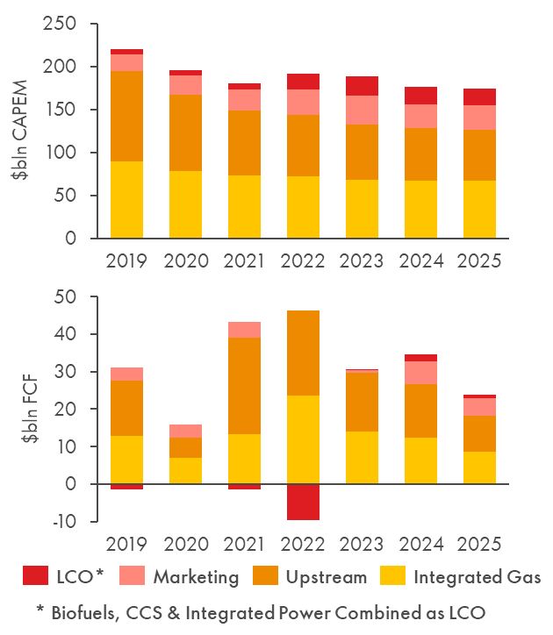
SHAPING GROUP DIRECTION
Project Orion (ETS 2027)
Delivering growth in a changing energy system
SHAPE
CONNECT
ACCELERATE
Thomas van der Meer & Thomas Akkerhuis
SCA Global Team F2F 2026 | 7–8 September
Three ingredients leading to aligned ETS principles
Energy system beliefs
System, demand, policy, innovation, carbon
CSP – SI&S team effort
Enables challenge
External environment
Legal & litigation
Regulation
Competitive landscape
Honest self-assessment
Competitive strengths
Vector deep dives
Past performance (chart)
Cross-SCA collaboration
Insights sample:
Insights sample:
Oil and gas remain significant into the 2040s
Low carbon returns have disappointed
Iteration with a learner mindset
EC
Board
IEA (SPS and CPS)
IEA (APS and NZE’50)
Electricity rises from ~23% to 40–60% by ‘50
Orion
ETS Principles
ETS Beliefs & Principles aligned with EC & Board
Solid basis for portfolio and carbon choices in Orion phase 2, aligned to capital allocation framework
Key Learnings
Data-backed conviction matters
Guards independent judgment
Avoids jumping to answers
Enables zooming out
Framing is essential
Avoids derailing discussions
Tailor the message
Preserve strategic core
Learning is non-linear
Expect detours
Plan for iteration
Shape. Connect. Accelerate.
September 7–8, 2026

